Slide 1
An (hopefully) Intuitive Introduction to Machine Learning
Rohan Sundar
Computer Vision Engineer @ Hictoronics

Slide 2
My Background
Currently work on real time object detection algorithms,
I am a graduate of Stony Brook University
Have done research on High Performance Computing.

Slide 3
The 30,000 ft view
The 3 main types:
Supervised ( the vast majority of ML success stories are of this type )
Unsupervised
Reinforcement Learning
The most useful methods in practice (IMHO)
Self Supervised learning ( a subset of Supervised learning )
Active Learning

Slide 4
The goal of any ML project
Your method should Generalize to unseen data.
Your model should be a model of the world, not a model of your dataset.
ML is inspired by Biology, but machines are far from alive. Temper expectations and set up a proper goal for your ML project in order to get the most out of these methods.

Slide 5
Supervised Learning
Find a mapping from provided features to a target label.
How? Minimize a loss function. Could be something like MSE ( Mean Square Error ) if it is a regression problem. Or a cross entropy loss if it is a Classification problem.

Slide 6
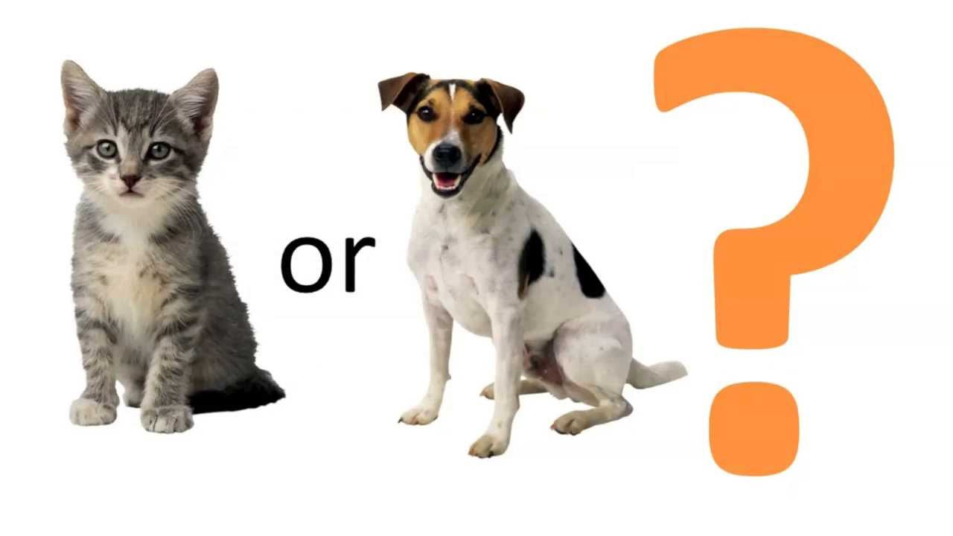
Supervised Learning

Slide 7
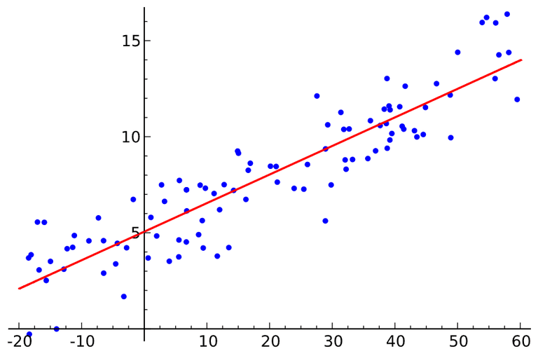
Supervised Learning

Slide 8
Unsupervised Learning
Find effective representation of the data, or in other words cluster your data.
Examples: Fraud detection in payment systems.

Slide 9
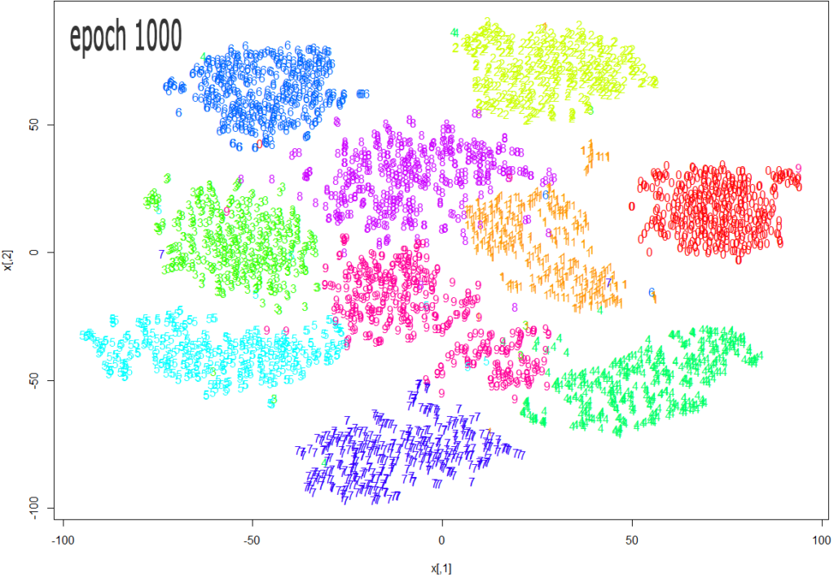
Unsupervised Learning

Slide 10
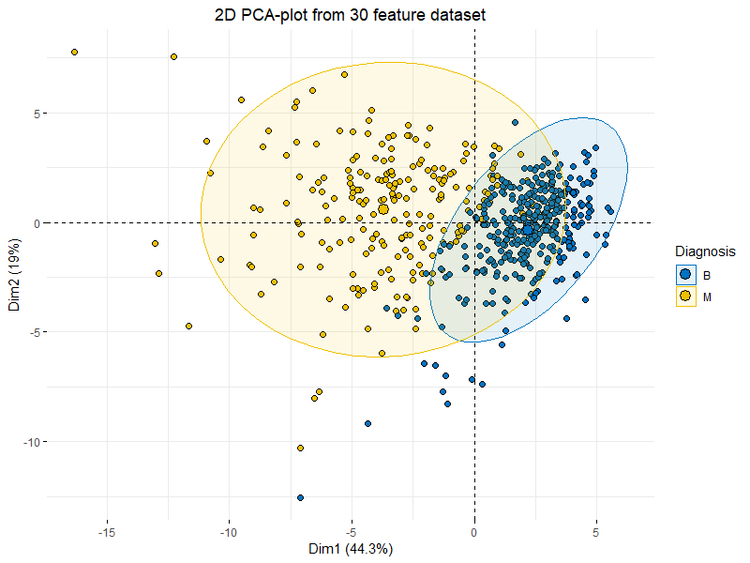
Unsupervised Learning

Slide 11
Reinforcement Learning
Put your agent in an environment you believe is representative of the problem you are trying to solve.
Let the agent find an effective ‘policy’ in order to minimize your cost function which you have defined in order to ‘win’ in your environment.
Examples Applications -> Game Playing agents such as AlphaGo, AlphaStar etc …

Slide 12
Semi Supervised Learning
Use the dataset to generate appropriate labels for your model to learn from.
Example -> De-noise your image to learn representation of the image.
Models that fall in this paradigm -> GPT-3, DeepImage Prior etc.

Slide 13
Active Learning
Query a user to label datapoints in order to eventually build a very effective model that works under very challenging circumstances.
Example -> Tag an object in a video stream and track it across multiple cameras.

Slide 14
Demo
Lets train a Resnet-34 to do fine grained classification of dog/cat per breeds.

Slide 15
The End!
Questions?

